Slide 1

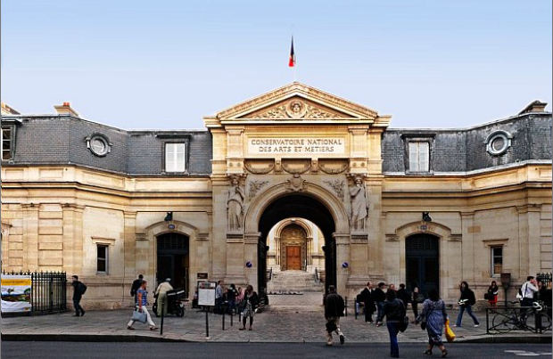
French Life
International Master’s Students at the Cnam academic, cultural and social life
Welcome to France / Paris!
Étudiants | Campus France : étudier en France
Amelia Rucart Rus
English & FLE Teacher
Phd in English studies
amelia.rucart@lecnam.net

Slide 2
Life in France
Plan
French Life
Introduction
The Cnam
Short presentation
Languages
Life in Paris
Libraries
Museums
Accomodation (Housing) & Costs
Healthcare & Support
Transport & Discounts
Social Life
Cultural Life (without castels & museums)

Slide 3
The Cnam
Short presentation
Accueil | Présentation | Cnam
Conservatoire national des arts et métiers | Homepage | Cnam portal | Cnam
Conservatoire national des arts et métiers | Accueil | Portail national | Cnam
Located in the heart of Paris and in two other different locations:
  Arts & Métiers / Marais district /Republique →St Martin and Conté
  Guy Lussac (in the 5th district of Paris)
  St Denis (rue Landy in suburbs)
Conférences/Seminars/Courses rooms
180 academic centres | Cnam portal | Cnam
Adresses et plans | Présentation | Cnam
Strong links with industry & research

Slide 4
The Cnam
Languages (CLE Departement):
Formations en anglais et en FLE - Langues étrangères | Communication en langues étrangères | Cnam

Slide 5
Life in Paris
Libraries
the Cnam:
Cnam - Bibliothèques | Les bibliothèques
Bibliothèque publique d’information (Bpi), Centre Pompidou:
Découvrez la Bpi et ses nouveaux espaces ! - Bibliothèque publique d'information | Bpi
    language (FLE) workshops:
Langues Archives - Agenda Bpi
National Library
Accueil | BnF – Site institutionnel
Other libraries (Bibliothèques de la Ville de Paris)
La liste des bibliothèques - Bibliothèques de la Ville de Paris

Slide 6
Life in Paris
Museums
Museum of the Cnam
Louvre Museum
Site officiel du musée du Louvre
Orsay Museum
Musée d'Orsay
Museums of City of Paris
Accueil | Paris Musées
Versailles Castel
Château de Versailles | Site officiel

Slide 7
Life in Paris
Accomodation (Housing) & Costs
CROUS residences: €350–450/month
Mon logement pour cette année 2025‑2026 - résultats de recherche - page 1 sur 2 - Trouver un logement dans une résidence universitaire
Cité Universitaire
Résidences universitaires à Paris | Un campus international | CIUP
The Cnam
Finding accommodation in Paris | Cnam portal | Cnam
Private studio: €700–1000/month (pap, seloger.com, real estates)
Shared flats common (“colocation”)
CAF housing aid helps reduce rent
CAF - Page d'accueil Allocataires

Slide 8
Life in Paris
Healthcare & Support
Free student health insurance (under conditions)
Vous êtes étudiant étranger et vous venez étudier en France | ameli.fr | Assuré
Access to French healthcare system
English pages | ameli.fr | Assuré
Cnam support services for integration & well-being

Slide 9
Life in Paris
Transport & Discounts
Imagine R pass: ~€350/year, unlimited travel (< 26 years) (metros, buses, trams) RATP, Sncf, Transilien
imagine R | Île-de-France Mobilités
ZsdJ20aF0TcGJQtP_SITE_1360_largeur_imagearticle@2x.png (2721×3652)
Navigo pass (>26 years)
Je gère ma carte Navigo | Île-de-France Mobilités
Taxis (G7, Alpha, Parisien), Uber, Bold, Vtc

Slide 10
Life in Paris
Shops
Carrefour, Monoprix, Franprix, Tang frère, Aldi, Action, Lidl, Auchan
Boulanger, Darty
Bricorama, Castorama, Leroy Merlin, Bhv, Ikea
Bookshops, music, films: Gilbert, Fnac

Slide 11
Social Life
Bars, Bistros
Restaurants (e.g Drouant, La Tour d’Argent, La closerie de Lilas, Le train Bleu)
Café (e.g. Les deux Magots, Flore, Lipp)
Students’ Restaurants (CROUS, Cité U, the Cnam – Paris, Landy)
French Gastronomy: Wine, Cheese, Good Food, Pastries, Cakes!
Foreign Food in Paris (Assian, African, South American, Eastern European Food)!

Slide 12
Cultural Life (without museums & castels)
Musical Life in Paris
  Cité de la musique (Philarmonie)
Page d'accueil | Philharmonie de Paris
Operas Bastille & Garnier
Concerts (e.g. Zenith, Olympia, Bercy Accor Arena)
Theaters (e.g. Chatelet, de la Ville, Champs Elysée, 13art)
Cinemas (e.g. UGC, Pathé, Mk2)
Cinéma à Paris : horaires des séances • L'Officiel des spectacles

Slide 13
Emergency Numbers
If you witness or are the victim of an accident, here are the emergency numbers to use :
SAMU (medical emergencies): 15
Police emergency: 17
Fire brigade: 18
European emergency number: 112
Emergency number for the deaf and hard of hearing: 114
For emergencies at sea: 196
For aeronautical emergencies: 191
Emergency numbers: what you need to know

Slide 14
Visit & Explore France
Weekend trips with low-cost transport (Blabla cars, Flixbus, Sncf, easyjet)
Strasbourg (EU institutions)
Nice (Mediterranean coast)
Lyon (gastronomy)
Biaritz & St Jean de Luz (Ocean & Surf)
Ile de Ré, Ile de Noirmoutier!

Slide 15
Thank you very much!

